Slide 1
Methyl Acetate Manufacture
Progress Report #2
Team T - Abdul Fayeed, Adarsh Kannan, Gavin Guerrera
April 7th, 2022

Slide 2
Overview: Topics to be Discussed
Carbonylation chosen as best route
Background for carbonylation and esterification
Block Flow Diagram (BFD) for carbonylation
BOE sizing and economics for carbonylation
Block Flow Diagram (BFD) for esterification
BOE sizing and economic results for esterification
Transfer price analysis for both routes
Route selection and Justification
Conclusions, Limitations, Future Steps

Slide 3
Background: Carbonylation
This is a two step process: Dehydration of MeOH, and Carbonylation of DME.
Reaction 1: 2 MeOH DME + H₂O (side reaction in esterification)
Can be catalyzed by Ion-Exchange Resin/H-Mordenite
Reaction 2: DME + CO MeOAc
Catalyzed by Acidic Zeolites H-mordenite
Potential Side Reaction: H₂ + DME CH₄ + MeOAc

Slide 4
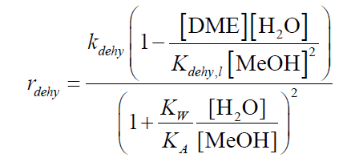
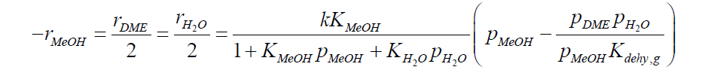
Background: Carbonylation (Rate Expression)
2 MeOH DME + H₂O
Ion-exchange resin catalyst
H-mordenite catalyst

Slide 5
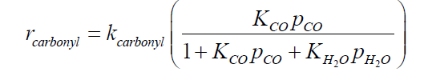
Background: Carbonylation (Rate Expression)
DME + CO MeOAc
H-mordenite catalyst

Slide 6

Background: Esterification
Reaction: MeOH_{(l)}+ HOAc_{(l)} MeOAc_{(l)}+ H₂O_{(l)}
Acid catalyzed reaction (ion-exchange resin catalysts)
Main Issue: MeOH-MeOAc and MeOH-H₂O Azeotrope
Side Reaction: 2 MeOH_{(l)} DME_{(l)} + H₂O_{(l)}
Potential issue: MeOH-MeOAc-H₂O Ternary could show VLLE behavior

Slide 7
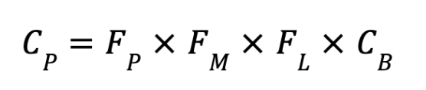
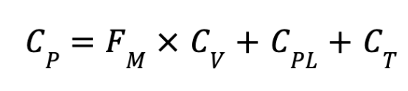
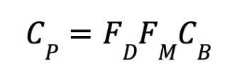
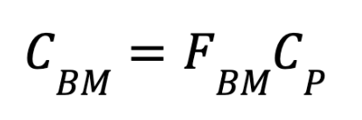

Economics Equations (Purchase Cost C_{P})
Heat exchanger
Distillation column/vertical pressure vessels
Compressor
Fired heater
Bare-module cost
The following equations were obtained from Seider, Seader, Et Al.

Slide 8
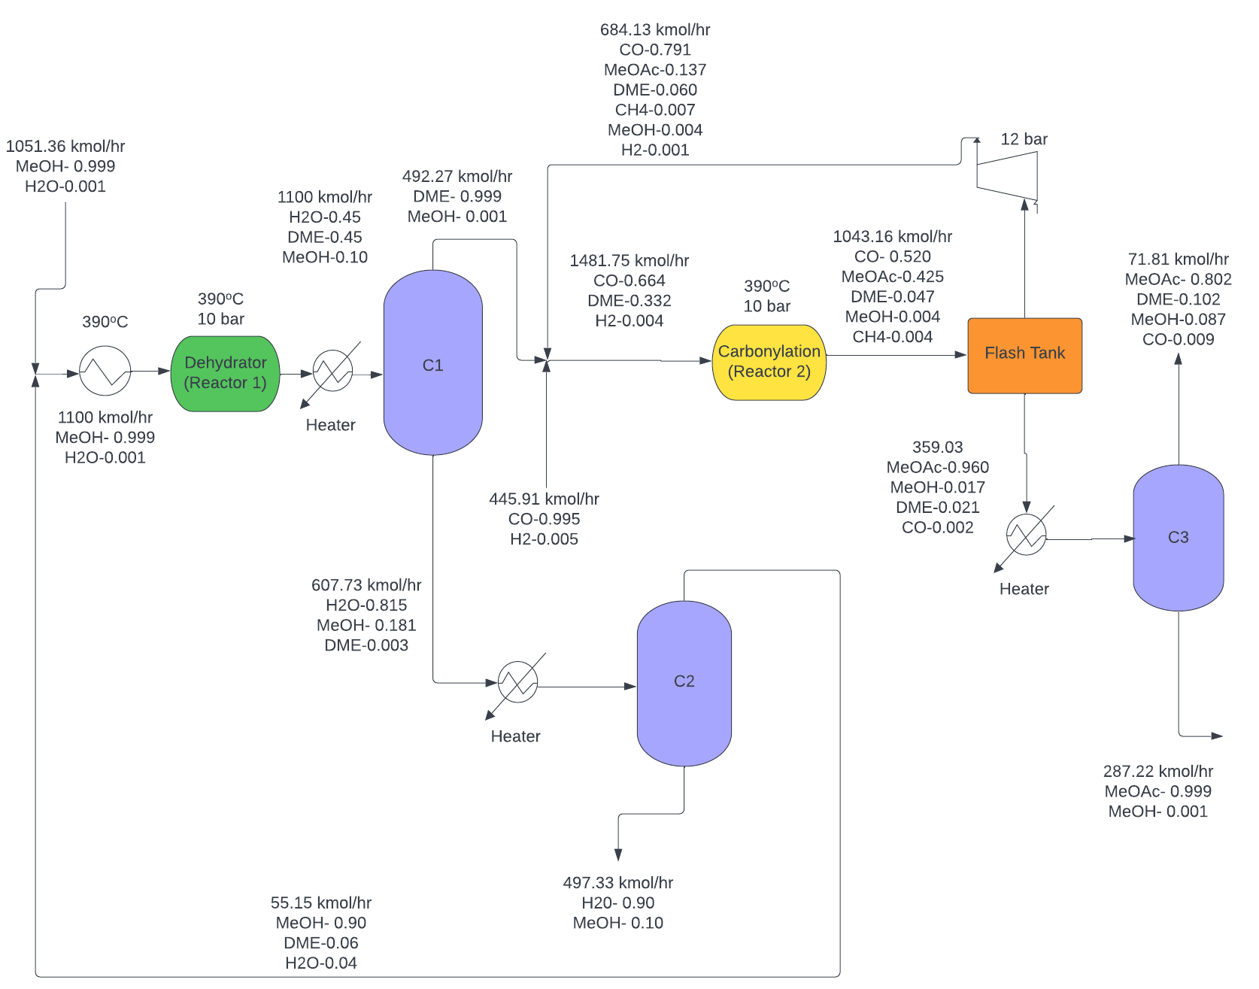
Process Flow Diagram : Carbonylation

Slide 9
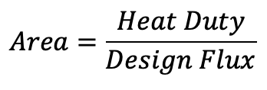
BOE sizing Carbonylation
Equipment | Area (ft²)
Heat Exchanger 1 | 1,555
Reboiler 1 | 3,899
Condenser 1 | 4,648
Reboiler 2 | 646
Condenser 2 | 581
Reboiler 3 | 1,217
Condenser 3 | 736

Slide 10
Carbonylation Pricing (C_{BM})
Equipment | Cost ($)
Distillation Column 1 | 629,415
Distillation Column 2 | 675,611
Reboiler 1 | 79,256
Condenser 1 | 90,021
Reboiler 2 | 30,477
Condenser 2 | 29,383
Heater 1 | 1,276,007
Heater 2 | 206,866
Equipment | Cost ($)
Reactor 1 | 928,609
Distillation Column 3 | 899,233
Reboiler 3 | 40,603
Condenser 3 | 90,021
Flash Tank | 126,213
Heater 3 | 309,525
Compressor | 2,643,986
Reactor 2 | 431,124
Total C_{BM}
$8.5MM

Slide 11
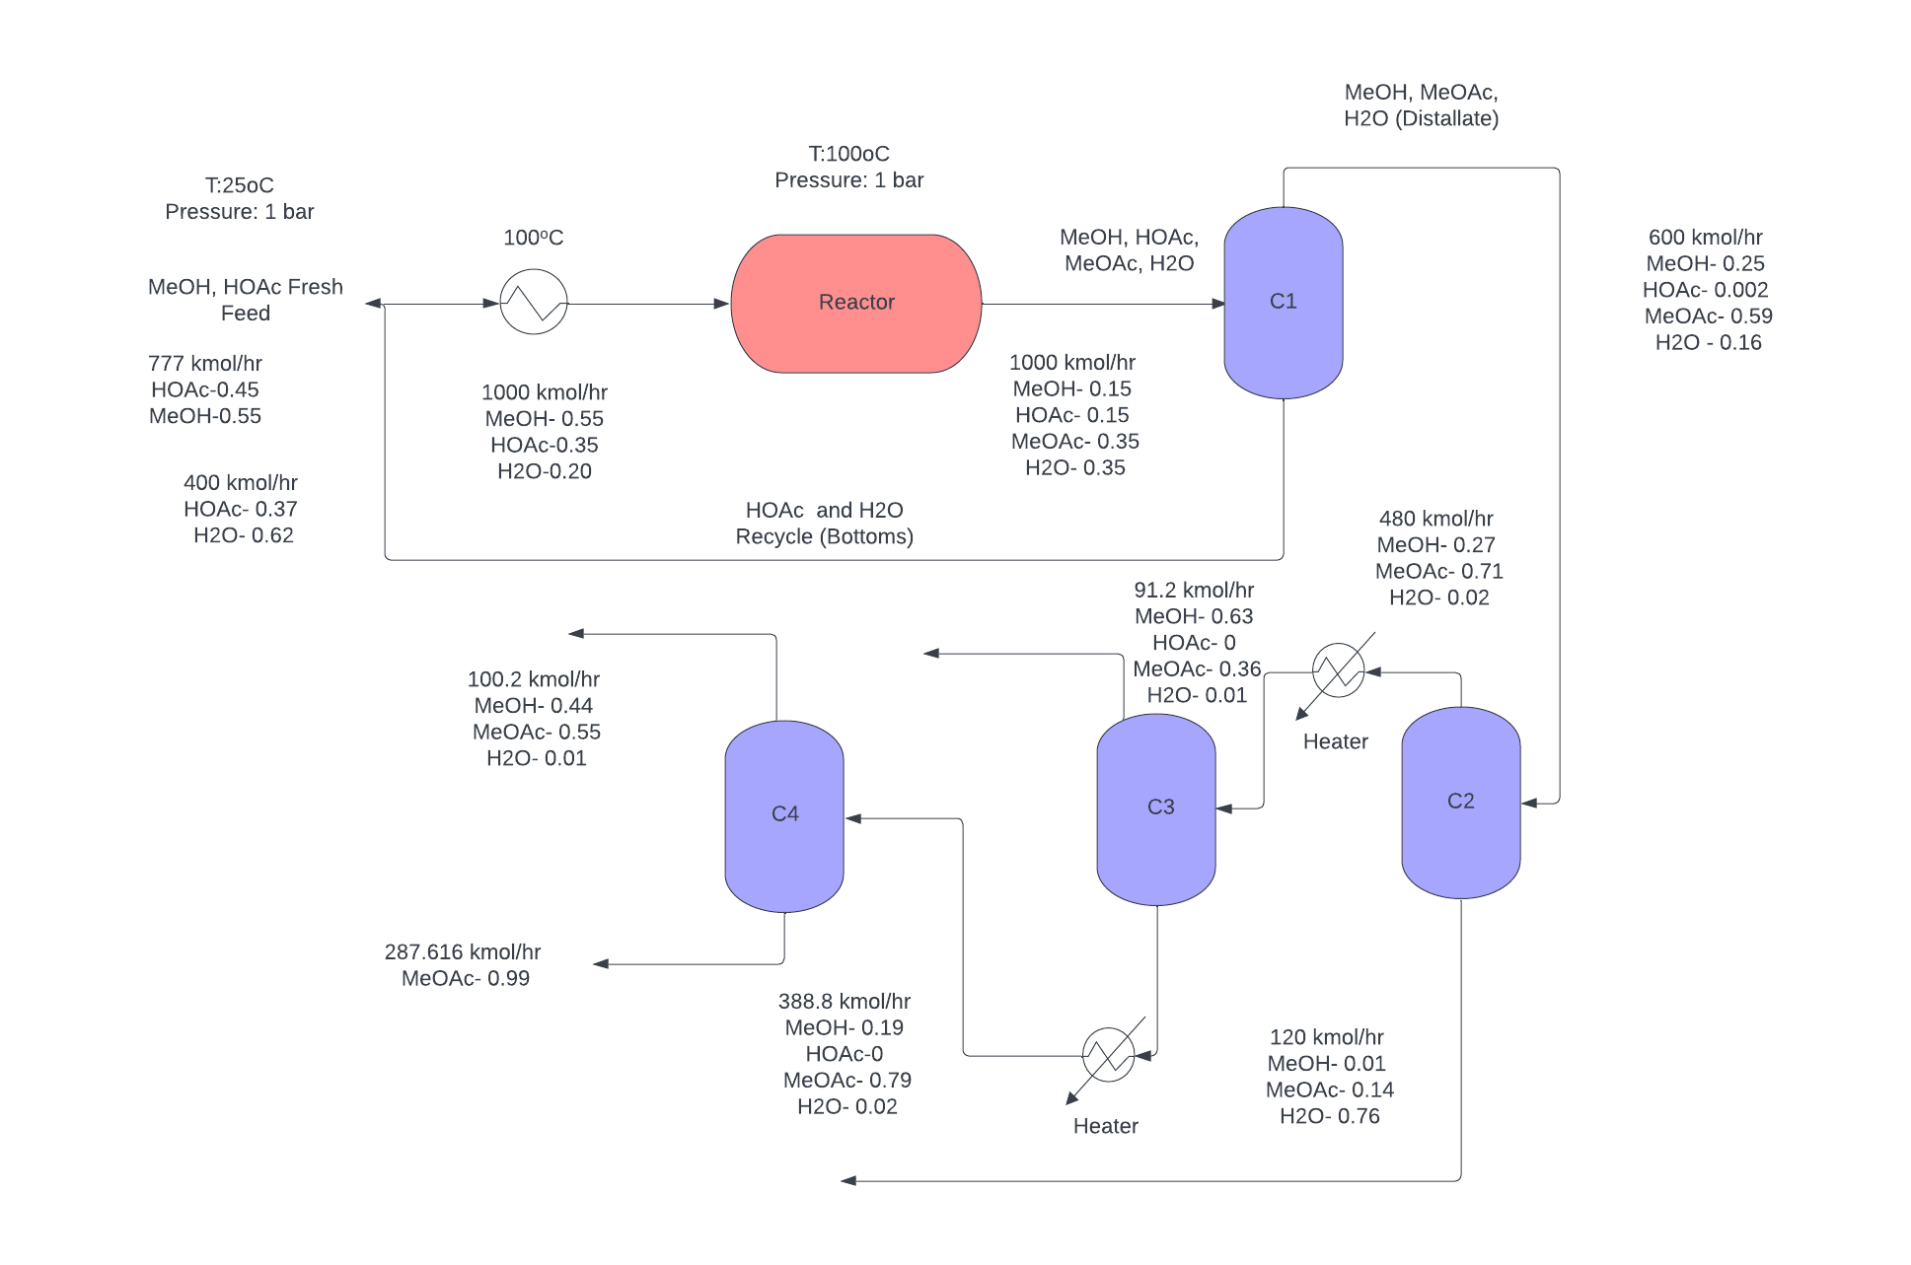
Process Flow Diagram : Esterification

Slide 12
BOE sizing Esterification
Equipment | Area (ft²)
Reboiler 1 | 2,350
Condenser 1 | 5,690
Reboiler 2 | 4,294
Condenser 2 | 4,329
Reboiler 3 | 2,064
Condenser 3 | 1,393
Reboiler 4 | 2,024
Condenser 4 | 1,409
Heat Exchanger | 736

Slide 13
Esterification Pricing (C_{BM})
Equipment | Cost ($)
Reactor | 431,124
Distillation Column 1 | 610,398
Distillation Column 2 | 625,769
Distillation Column 3 | 616,038
Distillation Column 4 | 633,767
Heater 1 | 283,552
Heater 2 | 444,732
Reboiler 1 | 56,684
Equipment | Cost ($)
Condenser 1 | 104,829
Reboiler 2 | 84,757
Condenser 2 | 85,269
Reboiler 3 | 56,997
Condenser 3 | 46,031
Reboiler 4 | 56,358
Condenser 4 | 46,296
Heat Exchanger | 32,731
Total C_{BM}
$3.9MM

Slide 14
Back-of-envelope Economic Analysis
Route | Carbonylation | Esterification
VGA ($MM/yr) | 25 | 11
COM ($MM/yr) | 215 | 285
Transfer Price @ 25% NROI ($/tonnes) | 1,454 | 1,903
Transfer Price @ 25% IRR ($/tonnes) | 1,490 | 2,420
Actual NROI (%) | 32 | 126
Revenue @ 350MMppy MeOAc ($MM/yr) | 253 | 411
NPC ($MM/yr) | -5 | -88
}
Companion Project (Recovery of DMAc)
Transfer price = $1,520/tonne

Slide 15
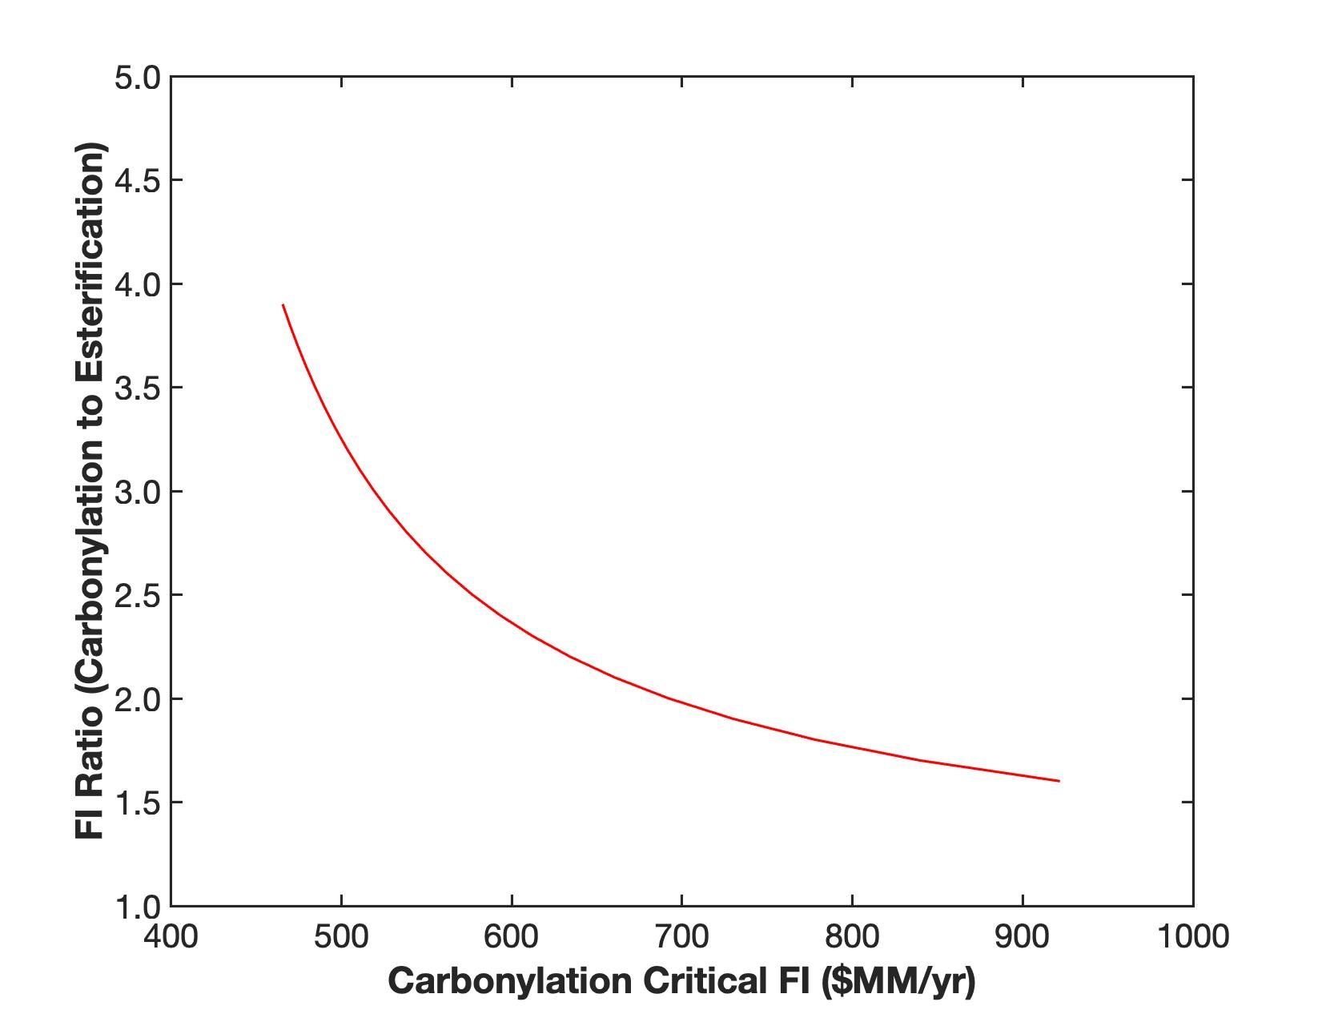
Updated Preliminary Screening Analysis
Worst case scenario to operate carbonylation route
using expensive materials on the equipments
Side reaction in carbonylation reaction

Slide 16
Justification of carbonylation over esterification
The fixed investment value for the crude carbonylation process is about $25 million.
Based on the locus of critical investment curve, this is well below the $500 million mark.
Furthermore, the recycle structure for the inlet stream to the dehydration was not optimized, which could result in further improvement of the process.
No side reactions were considered in case of esterification (optimal case), whereas a side reaction was considered in the case of carbonylation.
Finally, the transfer price for esterification was higher than that for carbonylation, implying that sales needs to happen at a higher price to achieve the same return.

Slide 17
Future Work
The next step is to run simulations pertaining to both the H-modernite and ion-exchange resin, to decide which catalyst to select.
Reactor analysis: PFR vs adiabatic.
Further optimization of recycle stream and separation structure, with final design, NPC, NROI and transfer price listing.

